Slide 1
Chapter 2 Field Programmable Gate Arrays

Slide 2
Outline
Introduction
A Brief Introduction to Digital Electronics
Bit Values as Voltage Levels
Transistor as a Switch
Logic Gates from Switches
FPGA Building Blocks
Layout of the Xilinx Artix7 XC7A35T FPGA
Input/Output Blocks
Configurable Logic Blocks
Interconnect Resources
Block RAM
DSP Slices
Clock Management
The XADC Block
High Speed Serial I/O Transceivers
Peripheral Component Interconnect Express Interface
FPGA based Digital System Design Philosophy
How to Think While using FPGAs?
Advantages and Disadvantages of FPGAs
Usage Areas of FPGAs

Slide 3
Introduction
An FPGA is itself a digital system composed of basic building blocks.
Therefore, some digital logic background is necessary to understand the FPGA architecture.
To do so, we start with the basics of digital electronics in this
chapter. Then, we explain the architecture of FPGA using abstract building blocks.
As we overview the FPGA architecture in this chapter, we focus on digital system design and implementation philosophy using FPGA.

Slide 4
A Brief Introduction to Digital Electronics
All digital devices are based on binary representation. In other saying, everything in a digital device is represented in terms of two logic levels as zero and one.
In its basic sense, we have two voltage levels to represent a binary digit (either as zero or one).
Let’s call these as ground (zero) and supply voltage (VCC).
These correspond to binary logic levels zero and one respectively.
Therefore, whenever we talk about a bit value as zero or one, we actually mean a voltage level as either ground or supply voltage.
Bit Values as Voltage Levels

Slide 5
A Brief Introduction to Digital Electronics
Transistor as a Switch
A digital circuit can be constructed by transistors. A transistor is an active circuit element used either as an amplifier or a digital switch.
The latter property is extremely important since all binary logic operations can be performed this way.
Instead of dealing with physical properties of a transistor, we can simplify its characteristics as follows.
Open circuit
Closed circuit

Slide 6
A Brief Introduction to Digital Electronics
Logic Gates from Switches
Buffer can be taken as a logic gate which feeds its input to output without changing it. It acts as a protective shield.
NOT gate can be constructed by a switch with two input pins as in Figure. In this setup, when input is equal to supply voltage the switch connects ground to output. Hence, output voltage will be zero. When input voltage equals to ground, the switch connects supply voltage to output.
Notes:
Buffer: minimize voltage loading effects between different elements, also compensates the voltage drop in transfer

Slide 7
A Brief Introduction to Digital Electronics
Logic Gates from Switches
OR gate can be constructed by two switches connected in parallel as in Figure. In this setup, when either the first or the second input is equal to supply voltage, output equals to supply voltage as well. For all other cases, output voltage equals to ground.

Slide 8
A Brief Introduction to Digital Electronics
Logic Gates from Switches
AND gate can be constructed by two switches connected in series as in Figure. In this setup, when both inputs are equal to supply voltage, then output equals to supply voltage as well. For all other cases, output voltage will be equal to ground

Slide 9
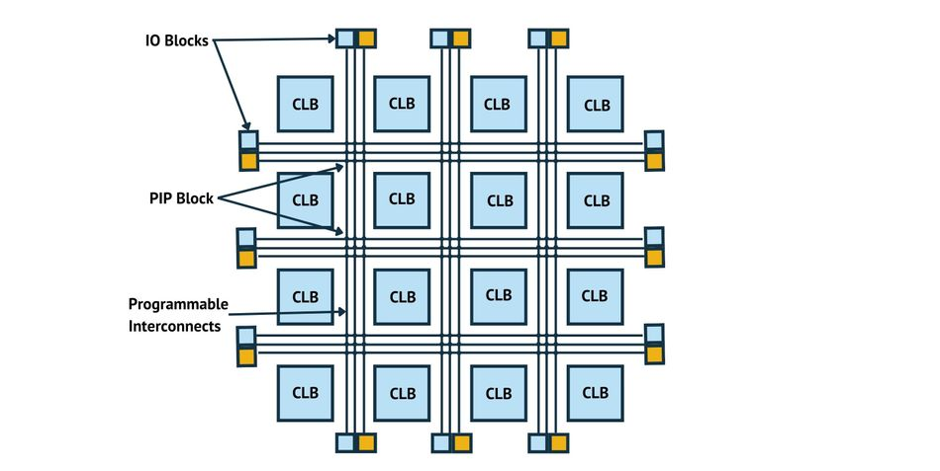
FPGA Building Blocks

Slide 10
FPGA Building Blocks
Layout of the Xilinx Artix7 XC7A35T FPGA
Basys3 and Arty boards have their FPGA from the Xilinx Artix-7 XC7A35T family.
The Xilinx Artix-7 XC7A35T FPGA is composed of nine components.
input/output blocks
configurable logic blocks (CLB),
interconnect resources
Block RAM (BRAM)
DSP slices
clock management block
XADC block
high speed serial I/O transceivers
PCIe interface

Slide 11
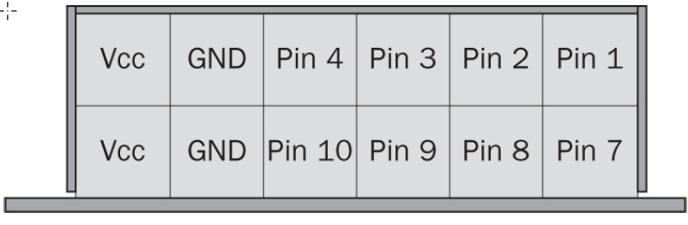
FPGA Building Blocks
Input/Output Blocks
A digital device interacts with the outside world through its input and output pins.
data from the outside world is acquired through input pins.
Output is fed to the outside world using output
I/O pins grouped into banks
Two pins in each bank are paired: positive and negative
Operate at the following modes
Single-ended Input
Single-ended Output
Reference
Differential
A sample Pmod connector on Basys3
Notes:
I/O pins are 100s.
Voltage 1.2v to 3.3v
In differential, input is recognized zero when the voltage at pin P is lower than the voltage at pin N.
In reference mode, input will be taken as logic level zero when input voltage is below reference voltage.

Slide 12
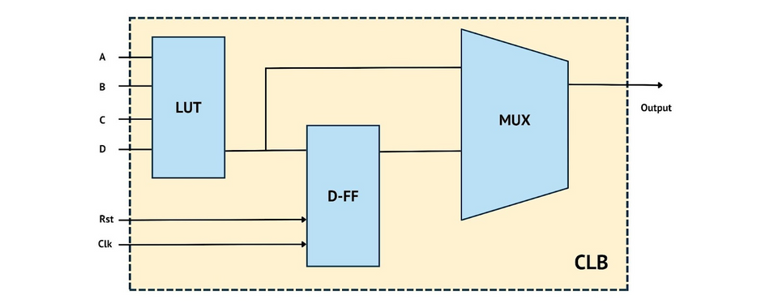
FPGA Building Blocks
Configurable Logic Blocks
CLBs are the basic elements used to implement a digital system on FPGA. At the heart of CLB lies look-up tables (LUT), flip-flops, and multiplexers.
Notes:
LUT can be used to implement any combinational logic function which has total number of variables as select pins.
Each variable value is stored in the corresponding flipflop

Slide 13
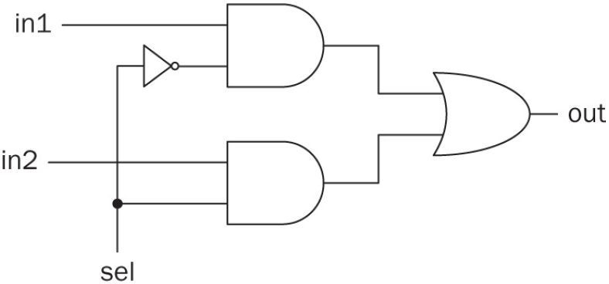
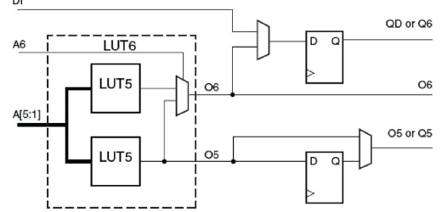
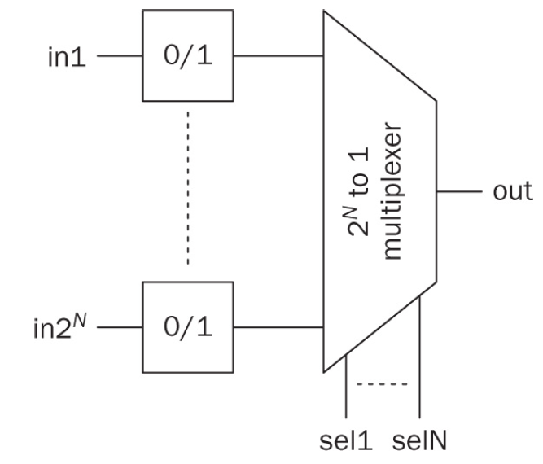
CLB Components
Mux
LUT
Artix-7 LUTs
Slices
Groups of LUTs, flipflops and multiplexers
Each slice: four 6-input LUTs, 8 flipflops, Muxs & other circuitry
SLICEM vs SLICEL
Notes:
Artix-7 has two 5-input LUTs in a CLB (producing different output from same input.
They can be combined using a multiplexer to form a 6-input one.
SLICEM can also be used as a writable memory element as well as shift register and distributed memory

Slide 14
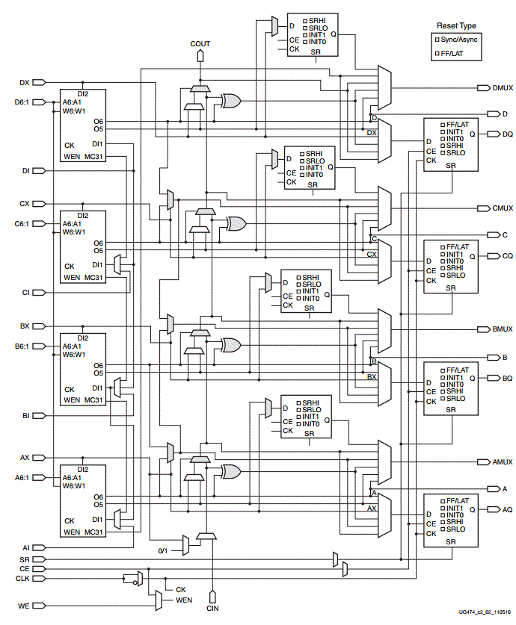
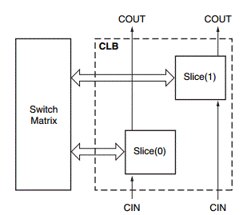
Artix-7 Slice
Notes:
Each CLB has two slices.
The fast carry logic is designed explicitly to realize a variation of a carry look-ahead adder. Consider the construction of a 4-bit adder with inputs A=a3,a2,a1,a0 , B=b3,b2,b1,b0 , and a carry in c0. Each slice of the adder can either generate a carry bit or propagate its carry in to the carry out.

Slide 15
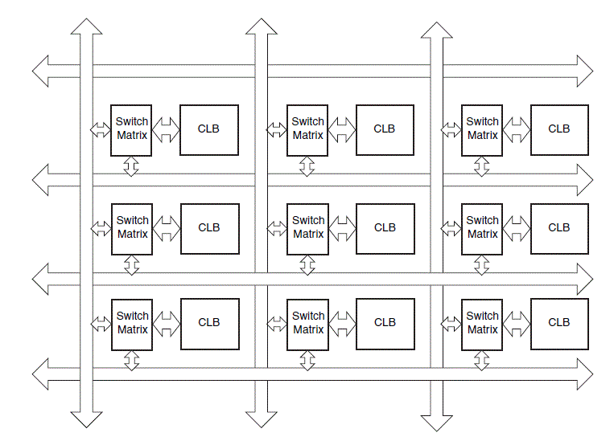
Interconnect Resources
Interconnect resources are a collection of wires and programmable switches. These are responsible for connecting CLBs and other building blocks within the FPGA. Interconnect is also called as routing channels.

Slide 16
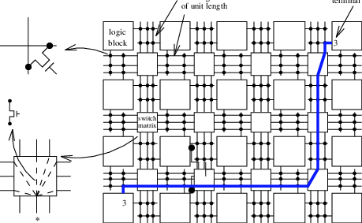
Routing Mechanism Example

Slide 17
FPGA Building Blocks
Block RAM
Block RAM modules can be used to store data. Moreover, they can form buffers, large LUTs or shift registers.
Artix-7 has 50 BRAMs of 36-kbits each with 64bit data width.
Clock Management
Artix-7 FPGA does not have an internal clock generating circuitry.
The user should feed a clock signal to the FPGA.
Some input/output pins are capable of receiving such clock signals.
As the clock signal is fed to the FPGA, it can be processed by the clock management tile (CMT) and distributed through FPGA.

Slide 18
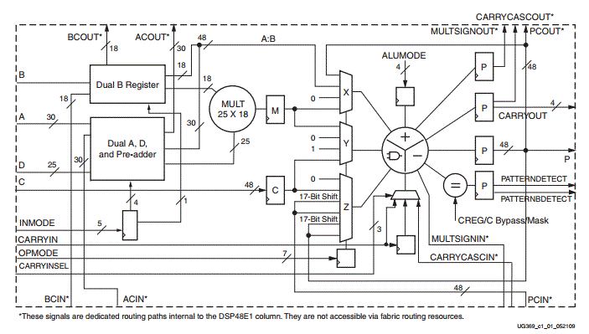
DSP Slices
Dedicated blocks for arithmetic and logic operations
90 DSP blocks in Artix-7
Multiplying two binary numbers of length 25 and 18 bits;
Adding, subtracting, and accumulating two 48-bit numbers;
Applying logic operations on two 48-bit numbers.

Slide 19
FPGA Building Blocks
The ADC Block
An analog signal can be processed by a digital system after being sampled and quantized by an ADC. The Artix-7 FPGA has 2 ADCs (XADC) which generate 12 bit samples.
High Speed Serial I/O Transceivers
High speed serial I/O transceivers (HSSIO) are specialized circuitry to communicate serial data @Gb/s speeds.
PCI Express Interface
PCIe is a high speed serial connection bus standard.

Slide 20
FPGA based Digital System Design Philosophy
How to Think While using FPGAs?
While using an FPGA for digital system design, the user is free to choose the design methodology.
In the beginning there is no predefined block to do the job.
There are hardware description languages (HDL)
HDL-based FPGA modules can be shared as IP blocks,
FPGA is reconfigurable after initial design has been done.

Slide 21
Advantages and Disadvantages of FPGAs
 | FPGA | ASIC | µController | Discrete
Feasibility range | High | High | High | Low
Speed | Moderate+ | High | Moderate- | Low
Space | Moderate | Low | Moderate- | High
Cost Low/ High Qty. | Moderate/ Moderate | High/ Low | Low/ Low | High/ High
Wiring | Low | Low | Low | High
Required Expertise | Moderate | High | Low | Low
Reconfigurability | High | Low | High | Low
TTM | Short | Long | Short | Moderate
Design simplicity | Moderate | Complex | Simple | Complex
Parallelism | High | High | Moderate | Low

Slide 22
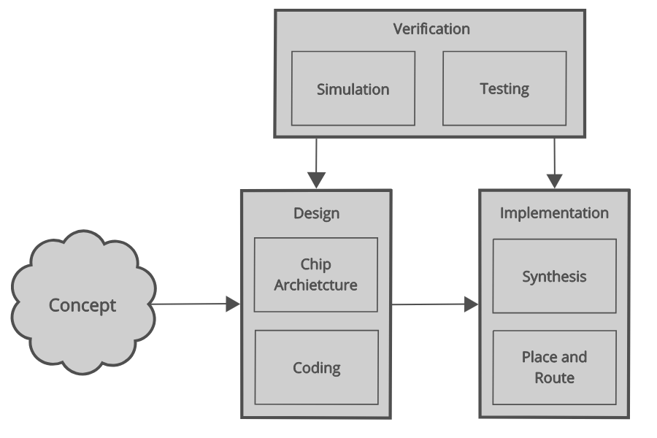
FPGA Design Process

Slide 23
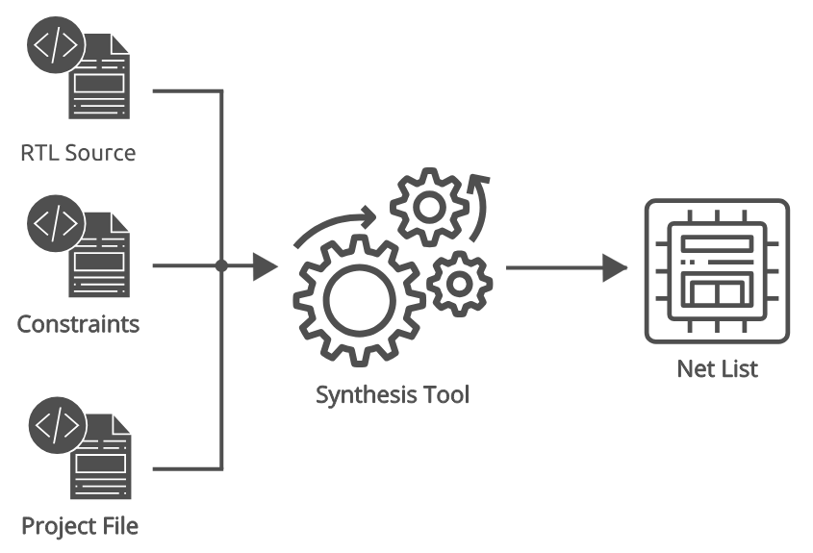
Synthesis Process
Notes:
RTL source: our source code of the circuit description
Constraints: timing contraints such as clock freq and timing of external interfaces
Project file: indicating the FPGA platform to synthesize for

Slide 24
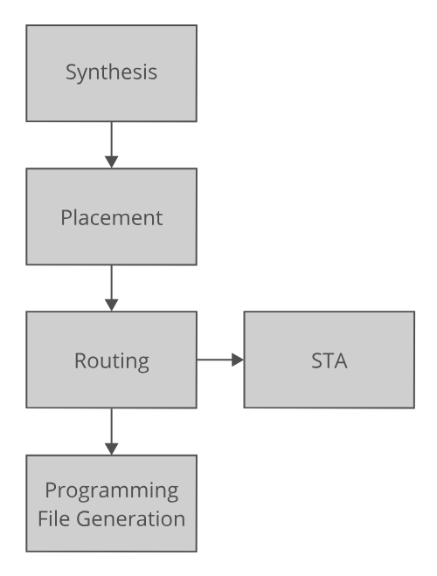
Implementation Process
gates and wires
FPGA CLBs & other components
CLB connections
Static time analysis
Final bitstream
Notes:
The synthesis process transforms our functional code into a number of interconnected gate level macros. These are models of the internal FPGA cells.
This process creates a netlist which describes what the contents of the programmed FPGA should be. We can think of this as being equivalent to a circuit diagram in traditional circuit design.
After we synthesize our design, we then map the netlist to the actual FPGA resources.
The first part of this is mapping the macros to the physical cells in the FPGA using a process known as placement. We can think of this as being equivalent to placing components on a circuit board when we design PCBs in traditional electronic design.
The second stage involves routing the interconnections between the different cells in a process known as routing. This process is equivalent to routing traces in a PCB.
It is normally necessary to run the place and route process several times in order to meet the timing requirements of our design. The place and route tool is responsible for scheduling these multiple runs based on our configuration.
We also perform a static timing analysis (STA) as part of the place and route process. This analysis calculates the delays for all of the timing paths in our FPGA and ensures that our design meets with our timing requirements.
If our design fails the STA then we can't guarantee that our FPGA will work reliably. When this happens we either have to run the implementation process again with different settings or we must change our design.
The final stage in implementation process is generating the programming file which configures the FPGA.

Slide 25
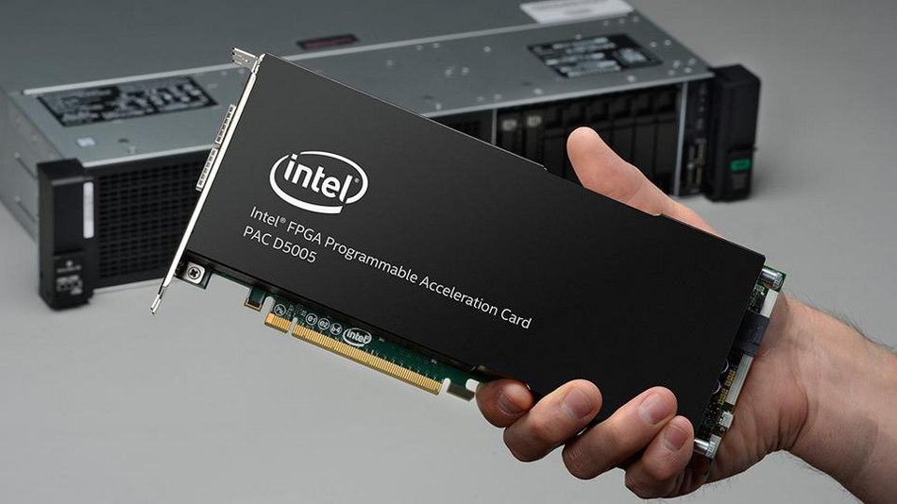
Usage Areas of FPGAs
FPGAs can be used in almost all areas where digital systems are needed, including the following:
Multimedia applications (DSP):
Audio/Image/Video processing
AI and Machine Learning
Deep learning accelerators
Edge AI
Custom AI hardware
Networking
Switches and routers
Optical comm. (DWDM)
Wireless comm.

